Slide 1
Applications for UGRS
Carl Jukes, Applications Adviser

Slide 2
introduction
The UGRS application consists of two questions
Both questions are in two parts
Both have a word limit of 200 words
You can also provide ‘supporting information’

Slide 3
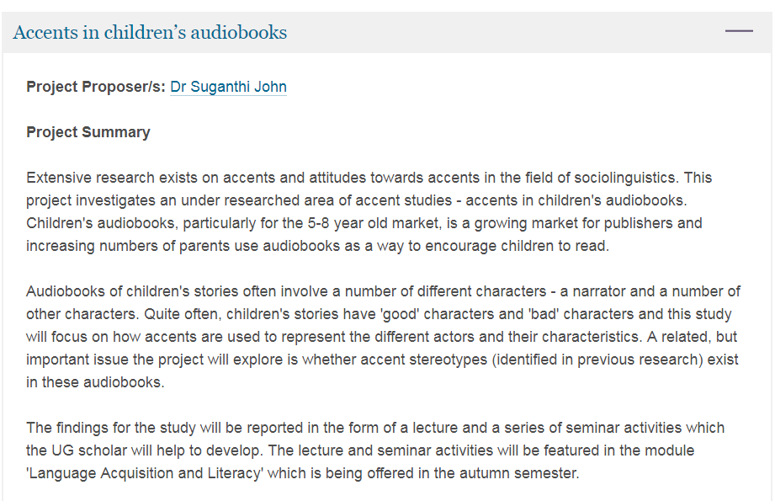
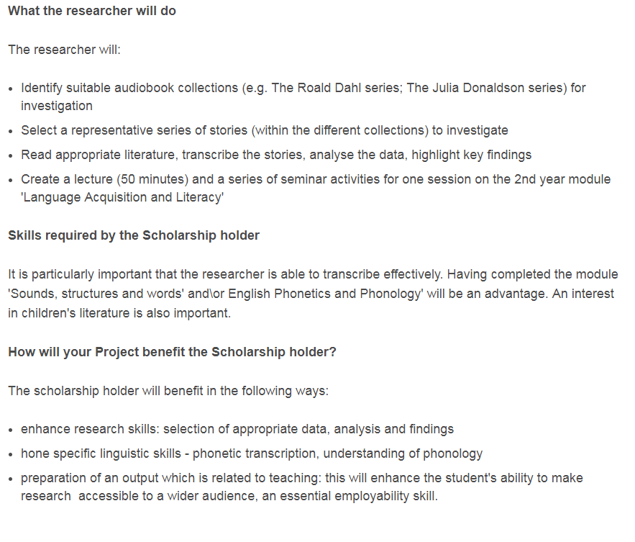
Read the project description

Slide 4
Question 1
Why would you like to be considered for this research project and what relevant experience could you bring to it? (max 200 words)
Notes:
2 questions:
-reasons for applying for the research project
-what relevant experience do you have?

Slide 5
Answering question 1
The 3 steps
Reasons
Importance
Consolidation
Notes:
Reasons - Write down as many reasons for wanting to do the research project as you can think of
Importance - Order them by importance, most important or significant reason first
Consolidation - Join up similar reasons or ideas, and delete any which you’ve already said in a different way
What you now have should be the basis of your answer
Do the same for relevant experience you can bring

Slide 6
Question 2
What are your career aspirations and how would this scholarship help you? (max 200 words)
Notes:
Again 2 questions:
-what are your career aspirations?
-how would the scholarship help (your career interests/aims)?

Slide 7
Answering question 2: career aims
What are your career aspirations is a big question.
You may not be sure of your career aims or have any particularly defined ones.
Notes:
What are your career aspirations is a big question.
You may not be sure of your career aims or have any particularly defined ones.
Look for an aspect of career interest which relates to academic research generally, and perhaps the field/area of the project you’re applying to
You may want to work with your subject or study discipline, or use expertise from deeper subject knowledge

Slide 8
Answering question 2: how the scholarship would help
Consider the context of the scholarship and the activities you would do:
Context:
academic research
higher education
research project
research purpose research aims how is it funded?
Who will read/use/engage with it?
how will it be disseminated?
Is it multi-discipline?
Multi-institutional?
International?
Wider place in culture, public sphere etc.
Notes:
Is any of this relevant to your career interests? Could be the basis of your answer

Slide 9
Answering question 2: how the scholarship would help
Consider the activities you would do:
Activities:
research-where? How? (methods/sources) records/databases, statistics, interviews, discussion/sharing ideas/problem-solving with academic ‘manager’
Proof reading/editing
conference planning
Meeting objectives, milestones
Notes:
Experiencing and developing a range of skills and professional behaviours, in research and more widely. Which are useful for your career interests, and why?

Slide 10
Other supporting information you would like to provide
Notes:
Anything else that you feel would support your application – perhaps thing you feel are relevant but you have not been able to express in the 2 questions.

Slide 11
summary
Answer both parts of the questions
200 words is very brief: focus and relevance
No wasted words
Show enough of your personal interests, experience and motivation. Ensure it reads as your ‘voice’ and not as if anyone could have written it

