Slide 1
Review of Key Findings – Skilling Property? Professor John Bryson City-REDI, University of Birmingham

Slide 2
Beyond Silos

Slide 3
Urban Living Birmingham
Promotes the development of integrated approaches to address the challenges faced by urban areas in the UK and to help them realise their visions for future urban living.
A focus on the development of a set of diagnostics leading to the identification of actions that will transform urban living.

Slide 4
Beyond Silos: Principle Component Analysis (PCA)
Identification of 248 datasets of the city.
Analysis of 58 variables to develop an integrated analysis to explore the relationships between individuals, households and place.
The PCA identified 14 significant separate groups of linked variables that account for 79.221% of the variance in the dataset.

Slide 5
Component 1: Deprivation, Skills, Health
Accounts for 17.9% of the variance and includes a relationship between income, deprivation, skills and occupation, rates of homelessness, elementary occupations, lone parent households, young population, low value housing.
The counter to this group is highly skilled residents, professional occupations, high incidence of self-employment and high levels of domestic gas consumption.

Slide 6
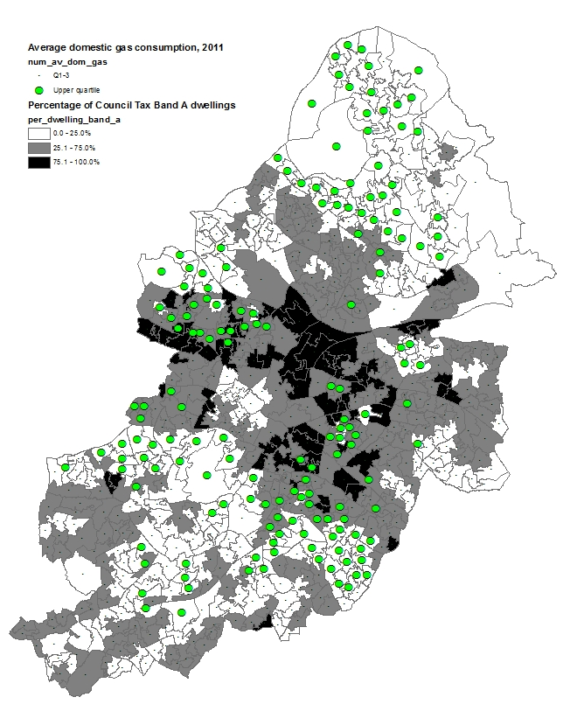
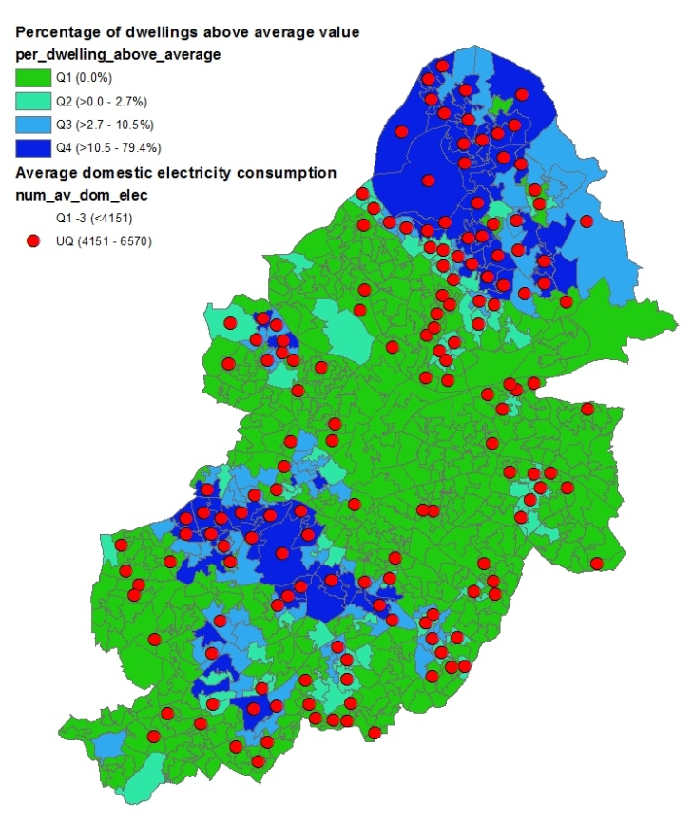
Figure 1: (a) Low value housing stock and domestic gas consumption; (b) Above average housing stock value and domestic electricity consumption

Slide 7
Component 3: Connectivity and Well-being
A relationship exists between subjective well-being and the connectivity of wards in terms of access to services and journey times.
Indicators include number of households with reasonable travel time by walking or public transport, travel time by public transport (morning rush), access to food within reasonable travel times.
High levels of well-being in the north of the city and a band south of the city core.

Slide 8
Skills Gap

Slide 9
Skills Gaps: Area covered
Greater Birmingham and Solihull:
Birmingham
Bromsgrove
Cannock Chase
East Staffordshire
Lichfield
Redditch
Solihull
Tamworth
Wyre Forest
Black Country:
Dudley
Sandwell
Walsall
Wolverhampton
Coventry and Warwickshire:
Coventry
North Warwickshire
Nuneaton
Rugby
Stratford-on-Avon
Warwick

Slide 10
Methodology
Supply
Based on ONS data (2004-2014) we forecast a supply of skills by NVQ level in each local authority and LEP area
Based on OE working age population forecasts (minus economically inactive) we calculated the absolute number of people with specific NVQ levels
Demand
We assumed Standard
Occupational
Classifications
(Major Groups) as:
Using OE occupation demand (2016-2020) we assumed NVQ demand
We compared NVQ supply and demand
SOC 2010 Occupation | NVQ
Managers and senior officials | 4+
Professional occupations
Associate professional and technical occupations
Administrative and secretarial occupations | 3
Skilled trades occupations
Personal services occupations | 2
Sales and customer service occupations Process, plant and machine operatives
Elementary occupations | 1

Slide 11
Supply/Demand Gap
over 3 LEP Areas

Slide 12
NVQ4 (Degree) by LEP area

Slide 13
NVQ3 by LEP area

Slide 14
NVQ2 by LEP area

Slide 15
NVQ1 by LEP area

Slide 16
NVQ Supply Demand Gap (Solihull)

Slide 17
NVQ Supply Demand Gap
(Redditch)

Slide 18
NVQ Level 4+ (Black Country)

Slide 19
NVQ Level 2 (GBS)

Slide 20
NVQ Level 4+ (GBS)

Slide 21
Implications
The skill gap analysis methodology is the first to be able to identify skill gaps at finer spatial scales.
The skills gap analysis can be layered over planned and proposed housing developments across the WMCA area. This shows that areas with skill gaps are also areas with housing shortages.
The business case for additional housing via the planning permission process should also contain reference to area-specific skill shortages.
Developing a systematic approach alerts us to the fact that a skills strategy has to be simultaneously a housing strategy and vice versa.
The WMCA devolution deal requires a focus on land-use planning as it relates to housing but combined with a skills and employment strategy.

Slide 22
Housing – Not in my backyard?
The WMCA and its partners must give immediate attention to the housing shortage across the WMCA area.
The skills do not exist within the existing travel-to-work- area and can only be provided by:
i) Developing new houses of particular types in
specific locations.
ii) Extending the travel-to-work-area – an
infrastructure investment.
iii) Well-being and connectivity and
employment/economic growth and housing and skills

